Slide 1

Topic- NLP to detect mental illnesses among social media users
ISM 6905 –Independent Study Project-
Dr. Balaji Padmanabhan
Mentor: Negar Maleki
Presented By: Adhithyan Rangarajan

Slide 2
Overview
We performed a literature review of current research in this space, understood the problem significance and methodology on detecting mental illness using social media data.
A reddit mental health dataset (344000 posts) from the Journal of Medical Internet Research was curated and used for training our ML models & scraped twitter data (408000 tweets) for users in Florida based on population density clusters was used for testing.
Analysis and recommendations were built based on model output metrics for the State of Florida & Florida Blue.

Slide 3
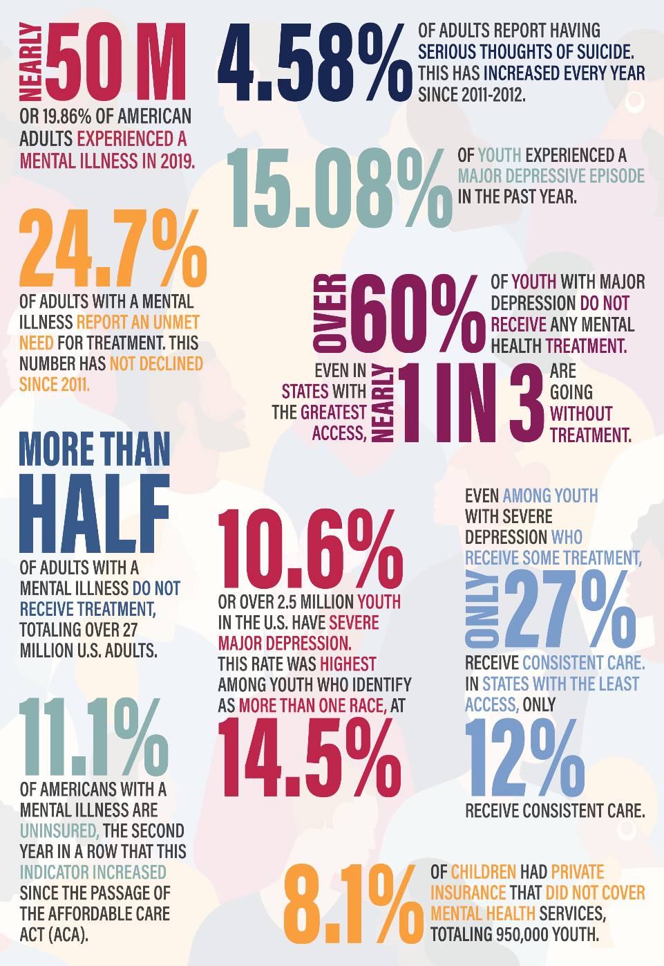
Problem Scale and Significance
In 2019, just prior to the COVID-19 pandemic, 19.86% of adults experienced a mental illness, equivalent to nearly 50 million Americans.
Over half of adults with a mental illness do not receive treatment, totaling over 27 million adults in the U.S. who are going untreated.
Over 60% of youth with major depression do not receive any mental health treatment.
Suicidal ideation continues to increase among adults in the U.S. at 4.58% this year i.e., an increase of 664,000 people from last year.
1 in 25 Americans lives with a serious mental illness, such as schizophrenia, bipolar disorder, or major depression.
1 in 5 Americans experience a mental illness in a given year. (52.9 million in 2020).
1 in 5 children, either currently or at some point during their life, have had a seriously debilitating mental illness.
11.1% of Americans with a mental illness are uninsured.
Sources – CDC, MHA National, National Alliance on Mental Illness

Slide 4
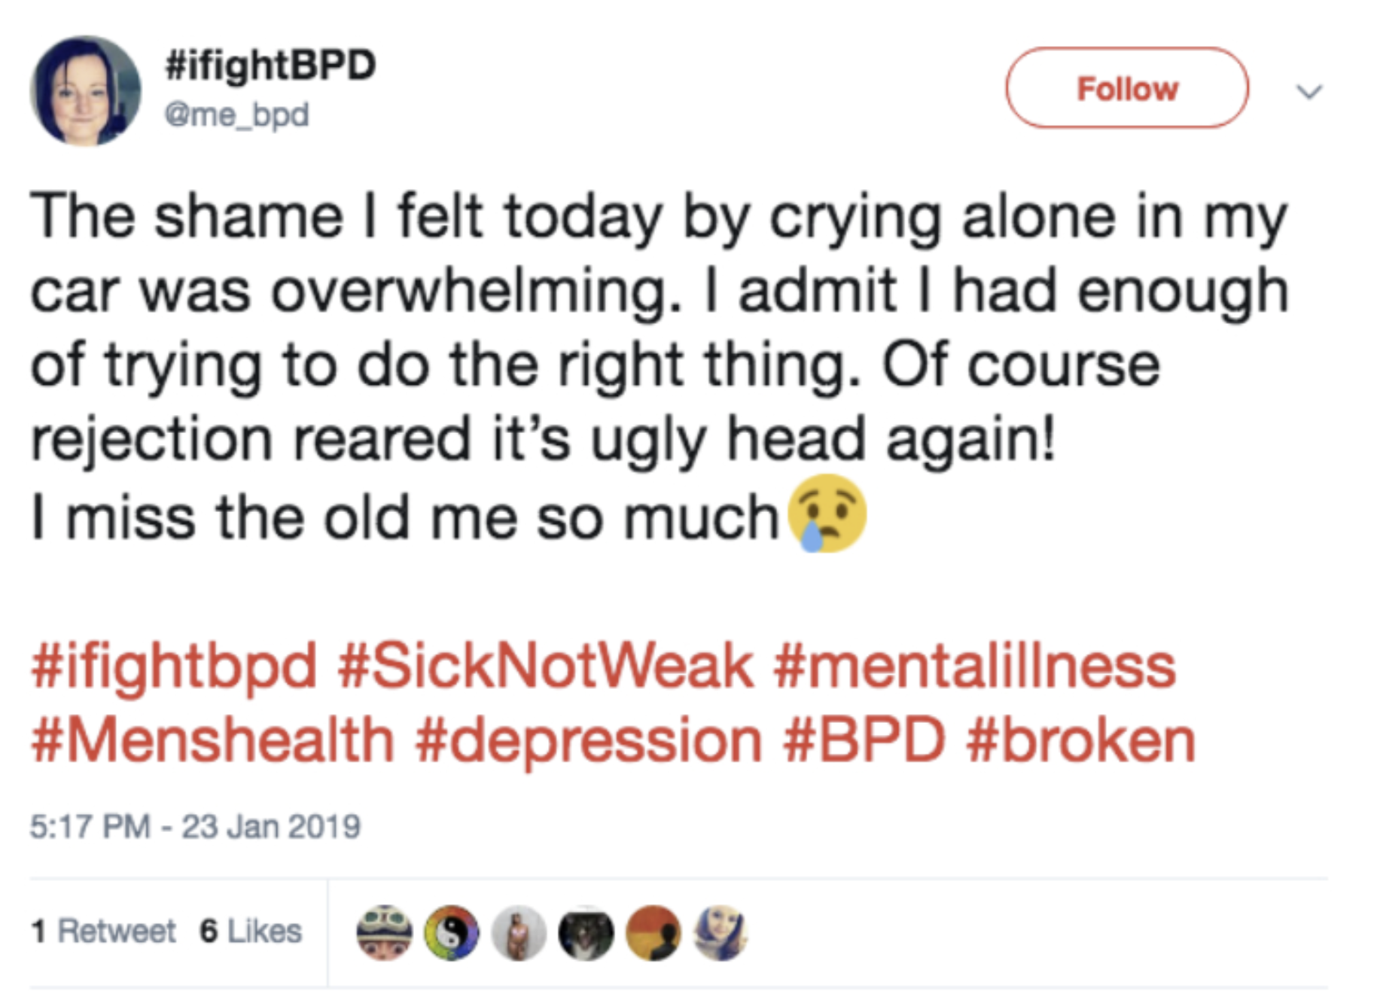
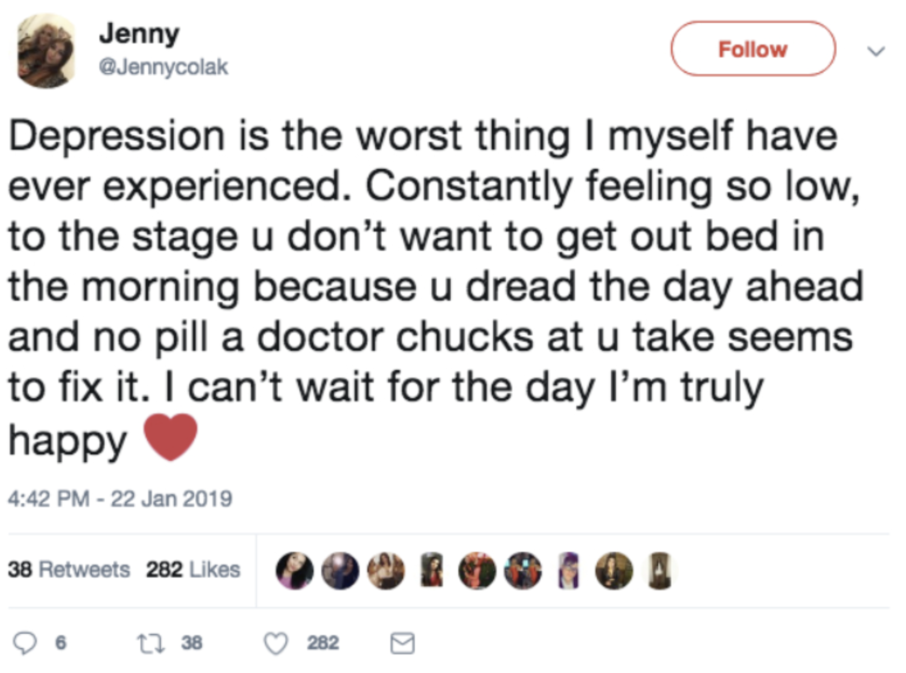
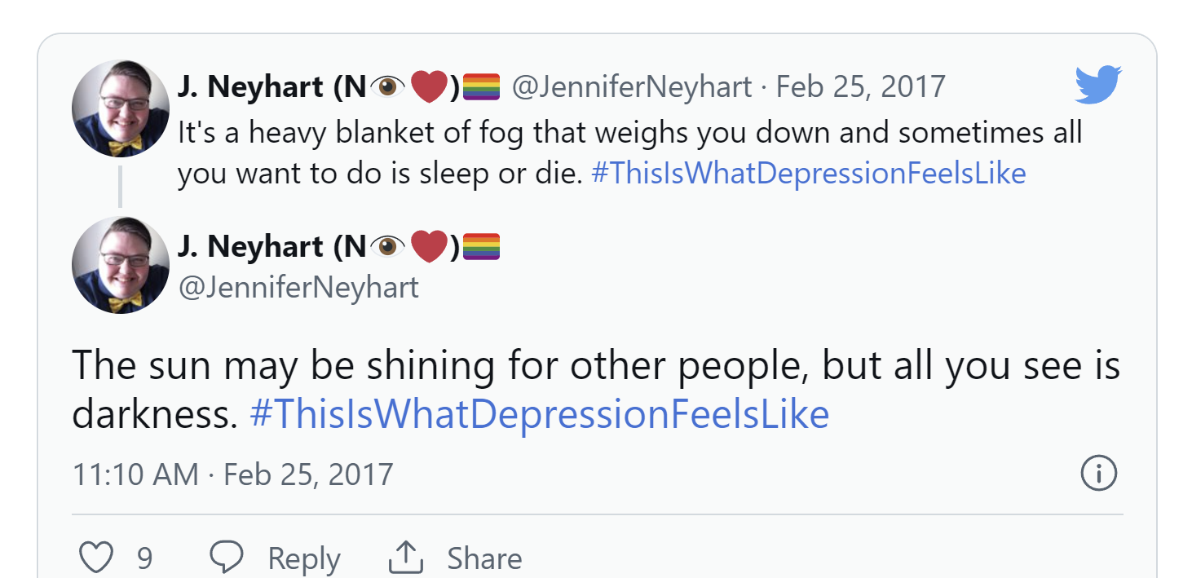
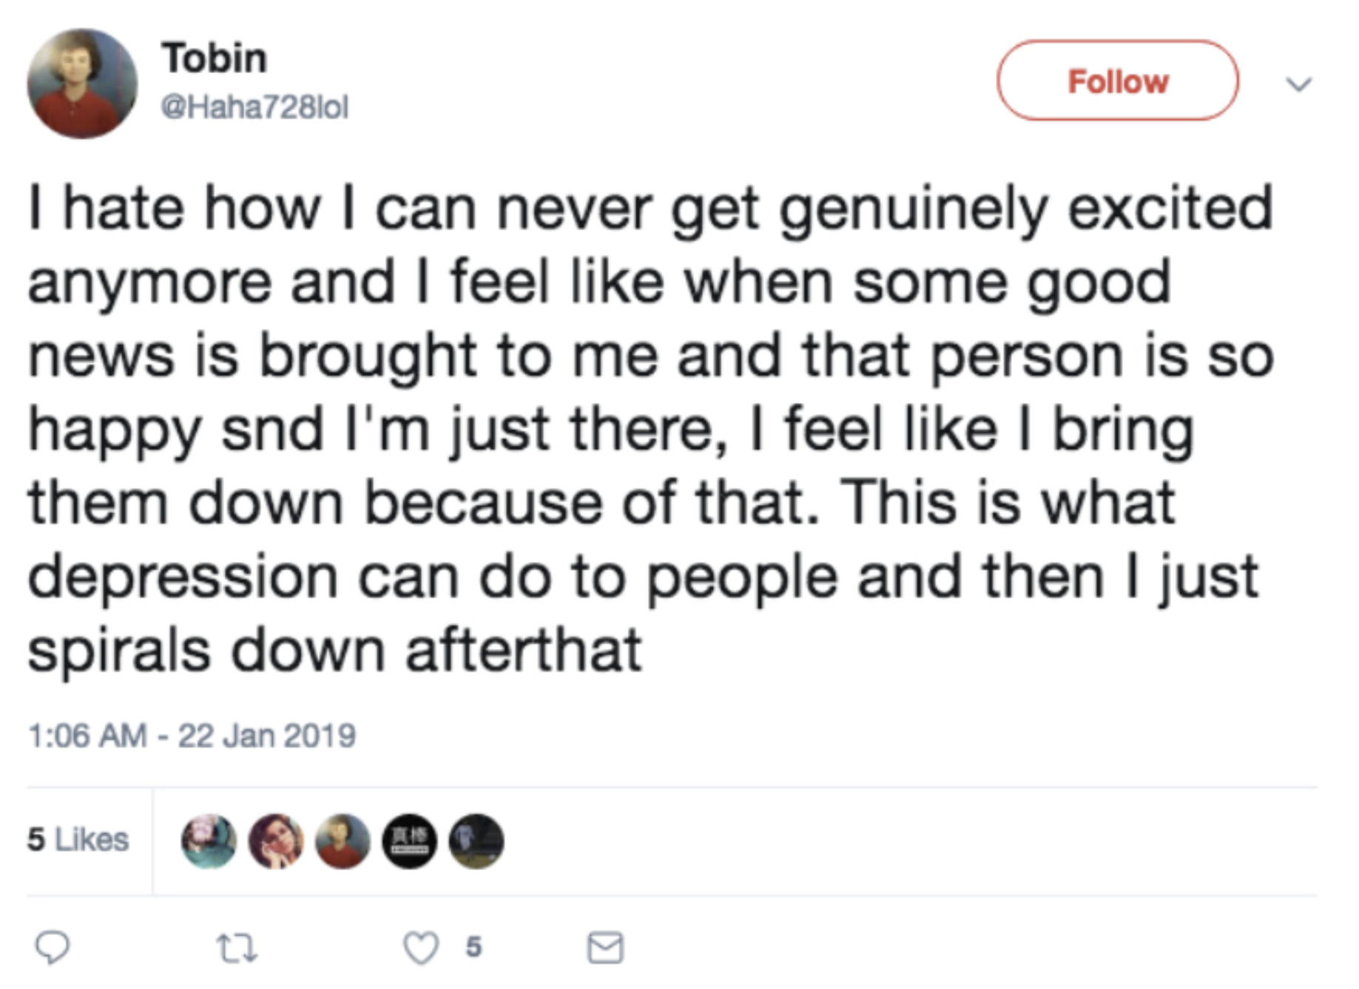
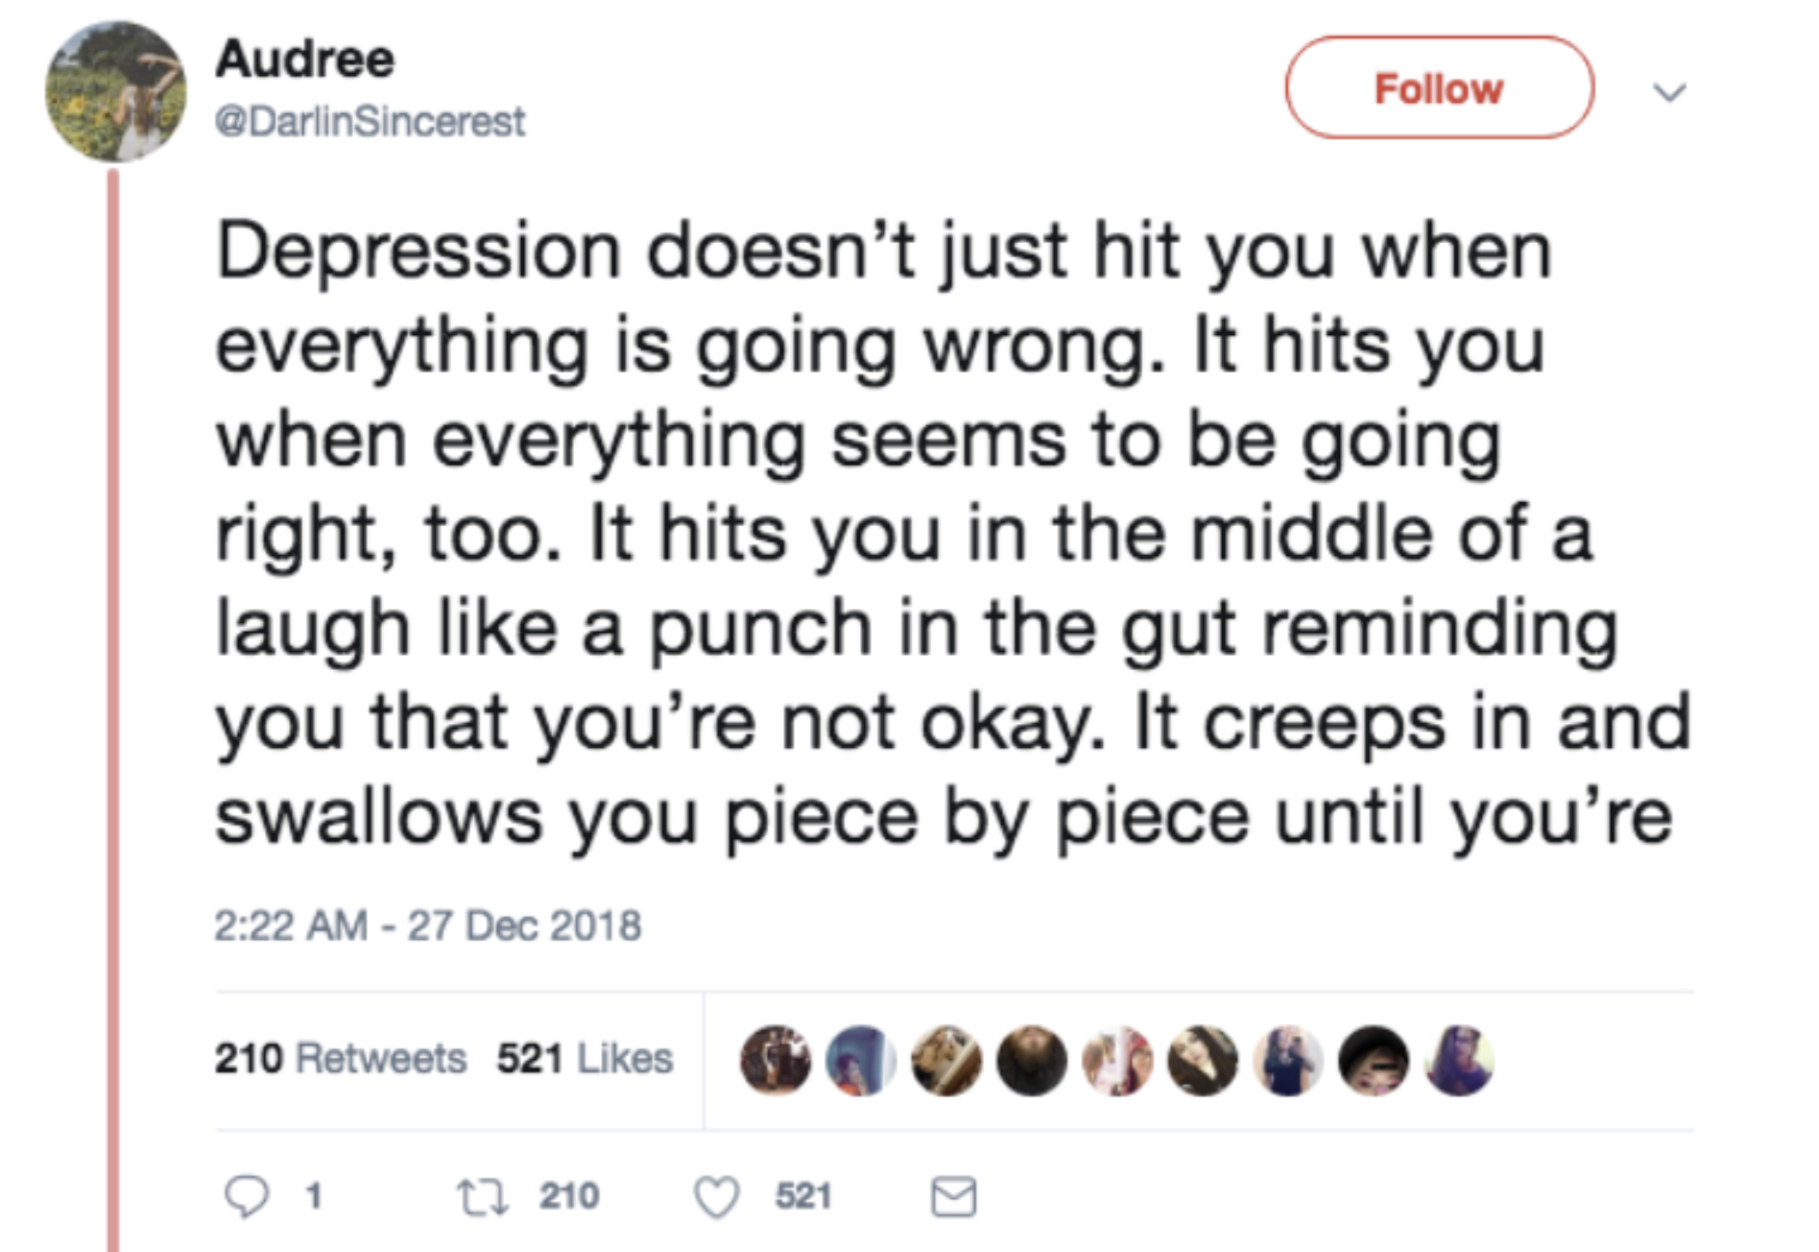
Tweets and Mental Illness

Slide 5
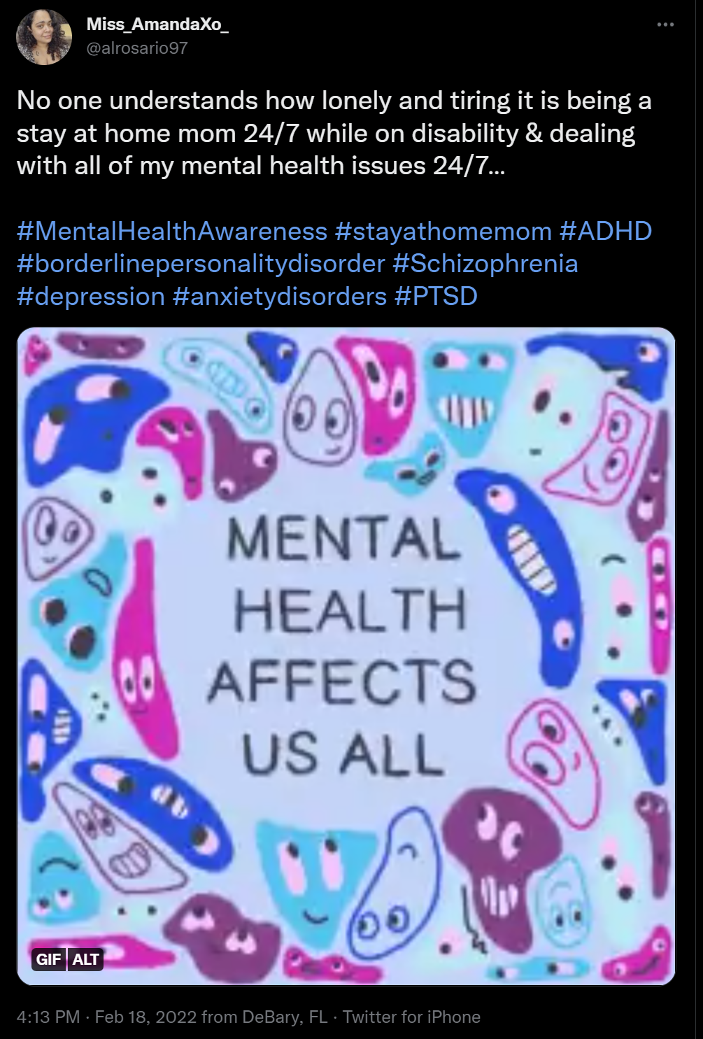
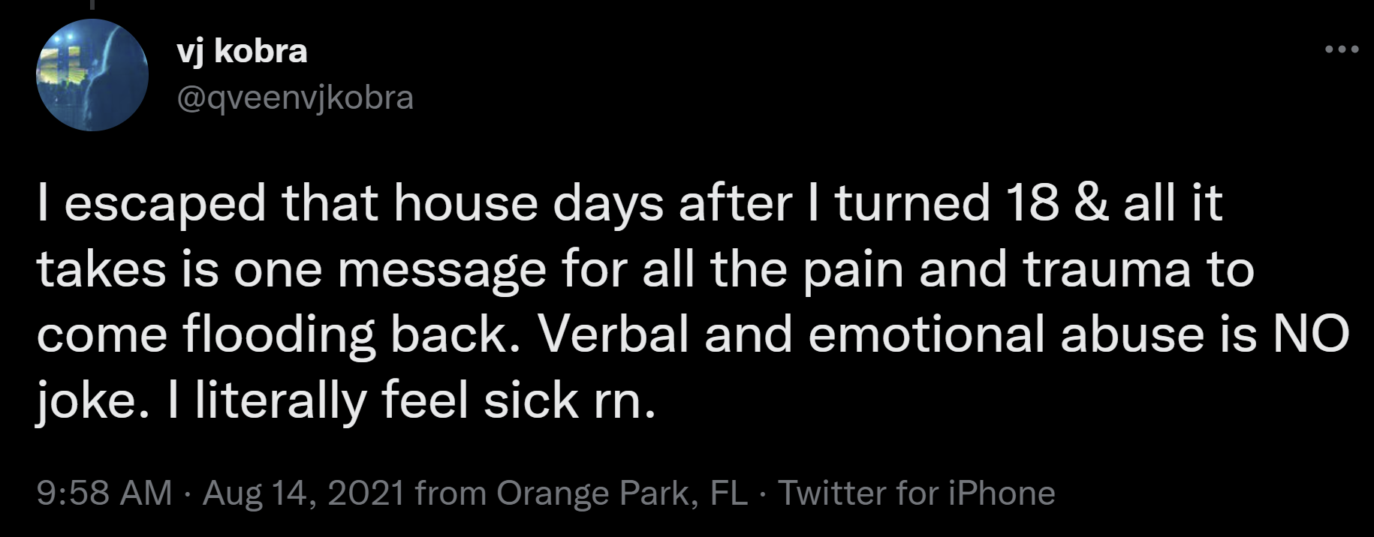
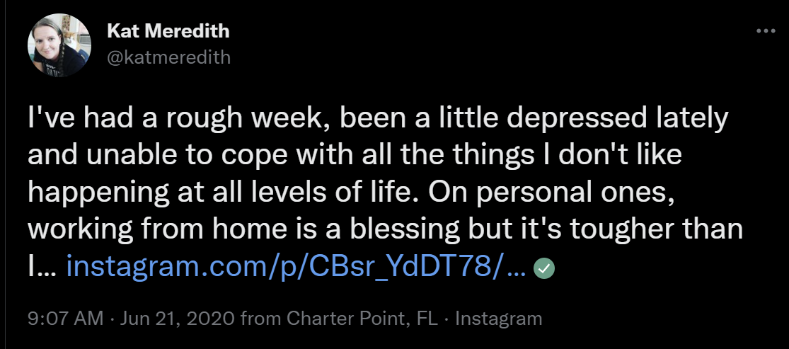
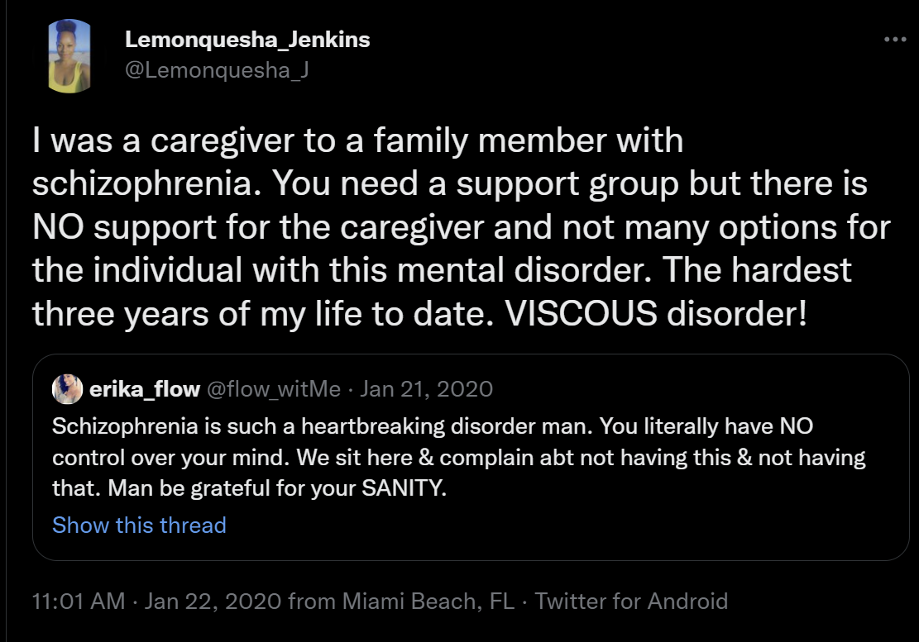

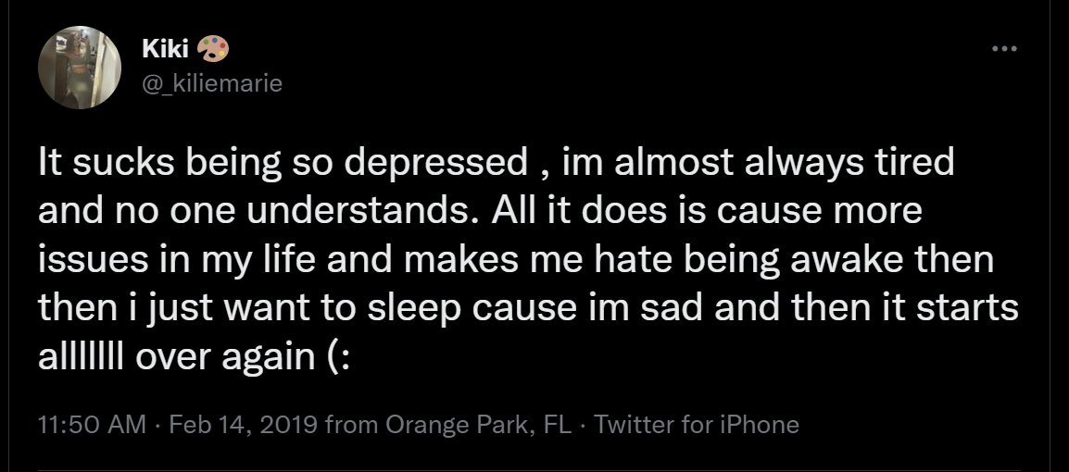
Some tweets from our dataset

Slide 6
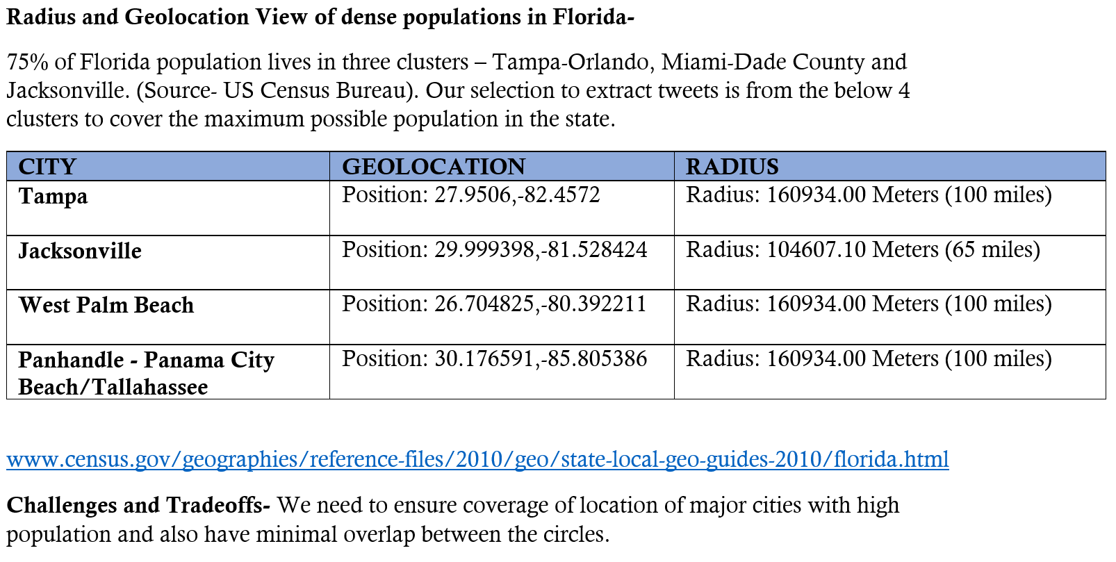
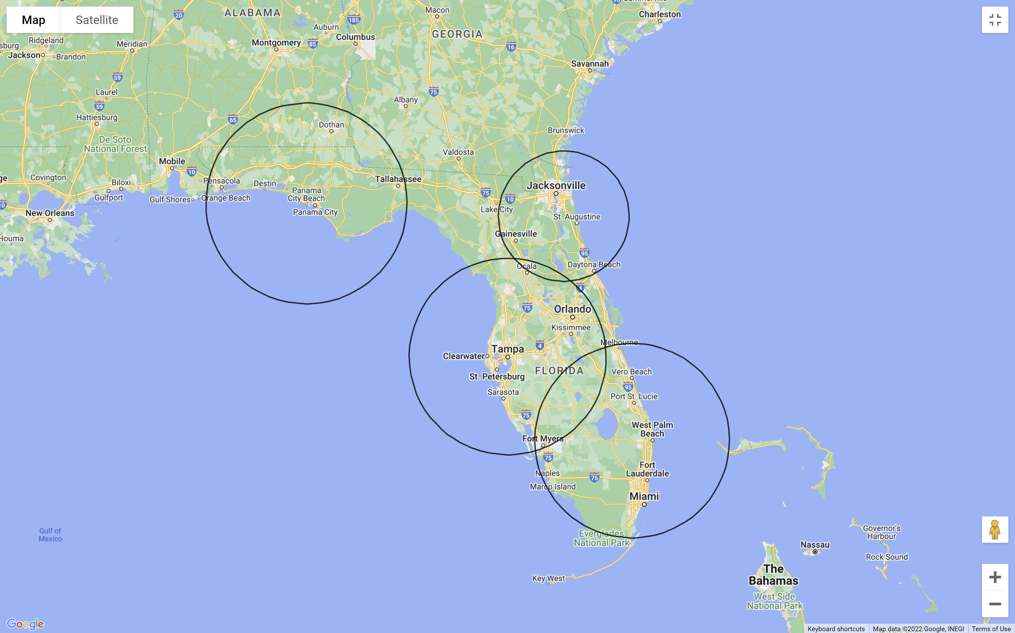
Methodology for Data Retrieval
Four clusters in Florida were used to pull the tweets for our dataset. These include Tampa, Miami, Jacksonville and the Panhandle.

Slide 7
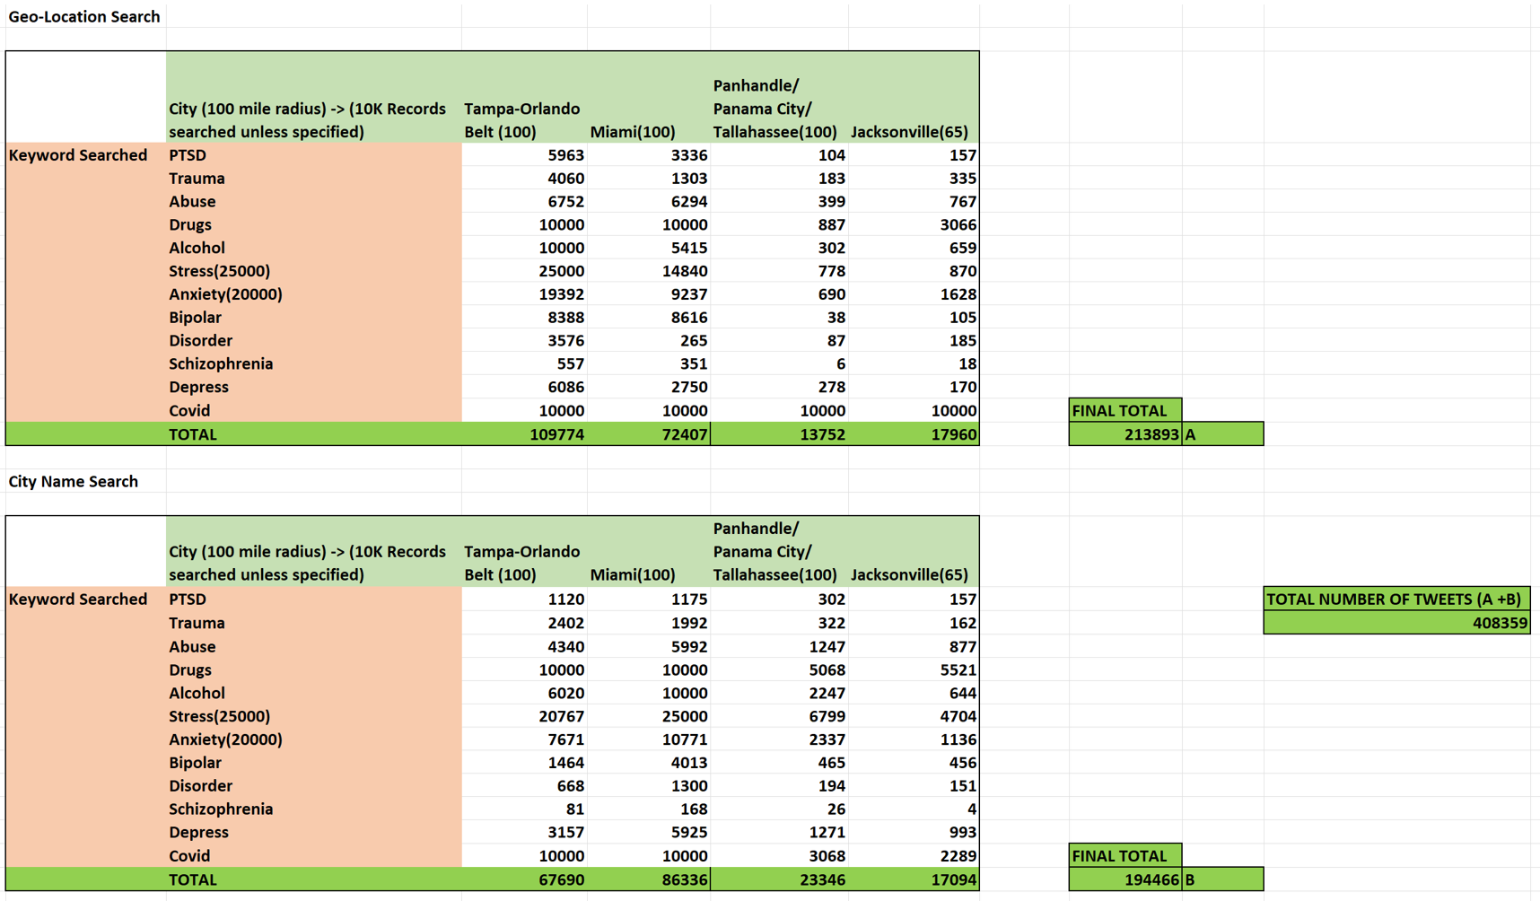
Data Sample Volume
Total of 408K tweets were pulled- 213K using Geo-Location & 194K using City Name to form our final dataset.

Slide 8
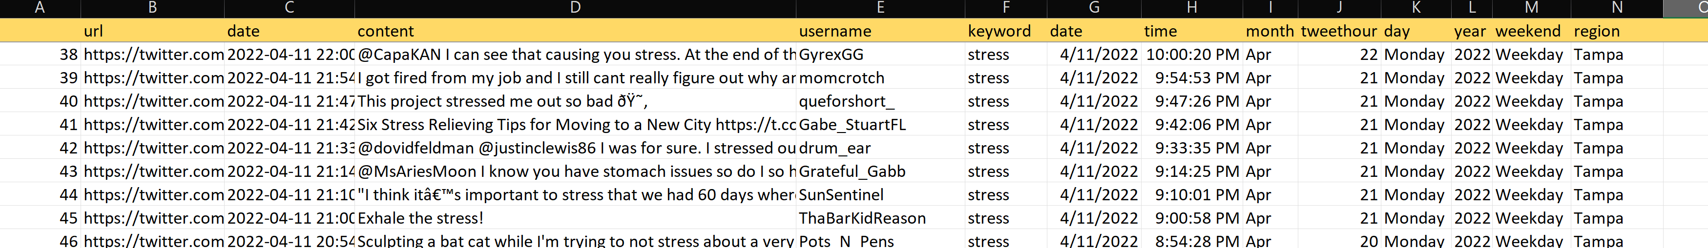
Twitter Dataset Sample
Post data extraction, this is a preview of the final dataset.

Slide 9
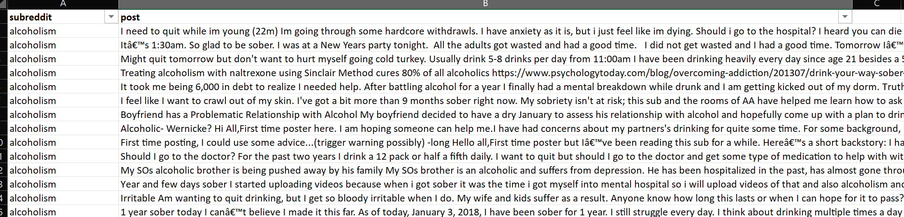
Reddit Content used for training the models
Reference - Low, D. M., Rumker, L., Torous, J., Cecchi, G., Ghosh, S. S., & Talkar, T. (2020). Natural Language Processing Reveals Vulnerable Mental Health Support Groups and Heightened Health Anxiety on Reddit During COVID-19: Observational Study. Journal of medical Internet research, 22(10), e22635
Reddit data preview –

Slide 10
Subreddits
Data from these subreddits were used-
Alcoholism
Anxiety
Bipolar
Depression
Health Anxiety
PTSD
Schizophrenia
Social Anxiety
Suicide watch
Mental Health

Slide 11
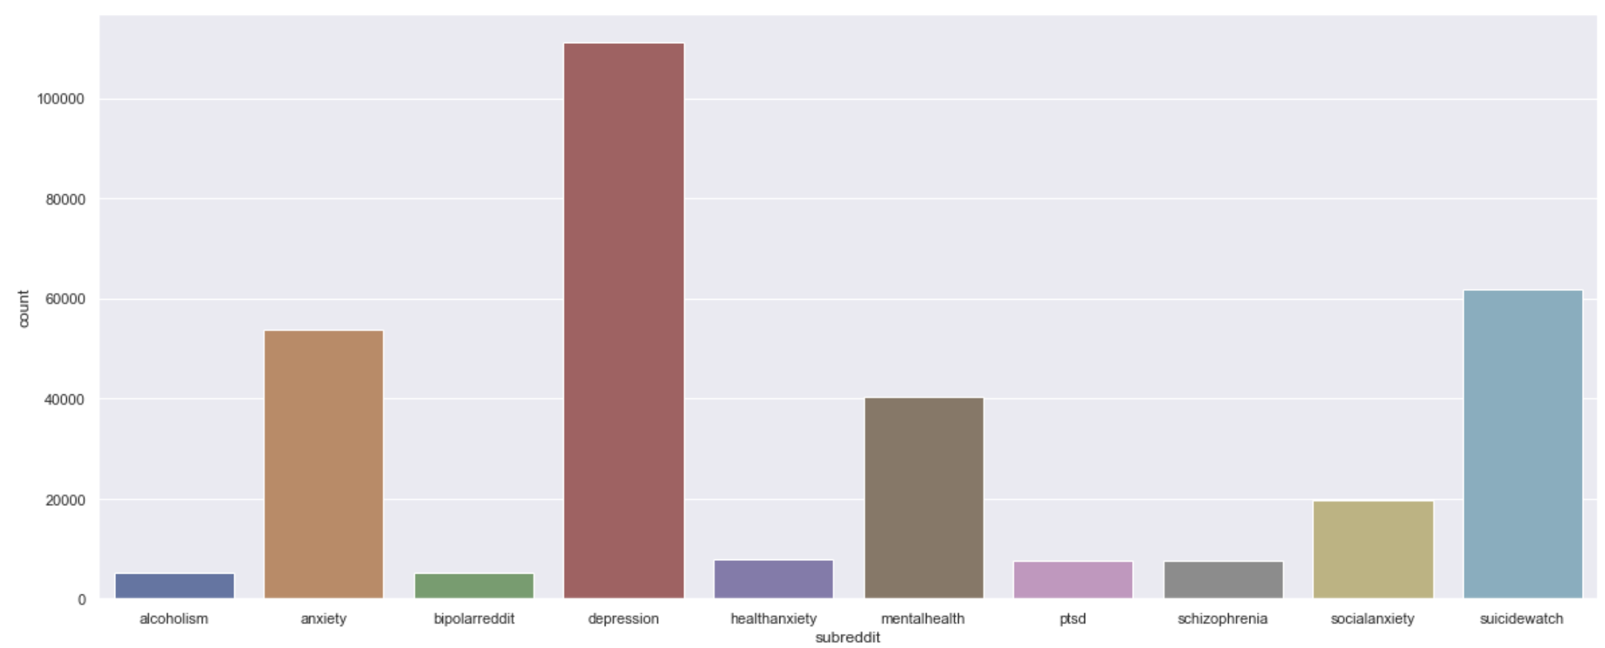
Reddit Data Distribution

Slide 12
Process and ML Models
Social media Data from Reddit’s top subreddit mental health channels were used to form a text corpus.
Reddit data was cleaned- Converted to lowercase, Punctuations removed, Tokenized, Lemmatized , Stop words removed and text was processed.
The processed text was trained for modelling using TF-IDF Vectorizer and n-grams.
This text corpus was used to train a Naïve Bayes model & a Multinomial Logistic Regression model.
Used the better performing trained multinomial logistic regression model with 74% accuracy to classify our twitter data of 408K tweets.
Tweets were cleaned and processed using same approach using NLP and then the trained model was used to classify the tweets into different mental illness/issue categories. Analysis in the next slide.
MODEL | ACCURACY
Naïve Bayes | 60%
Multinomial Logistic Regression | 74%

Slide 13
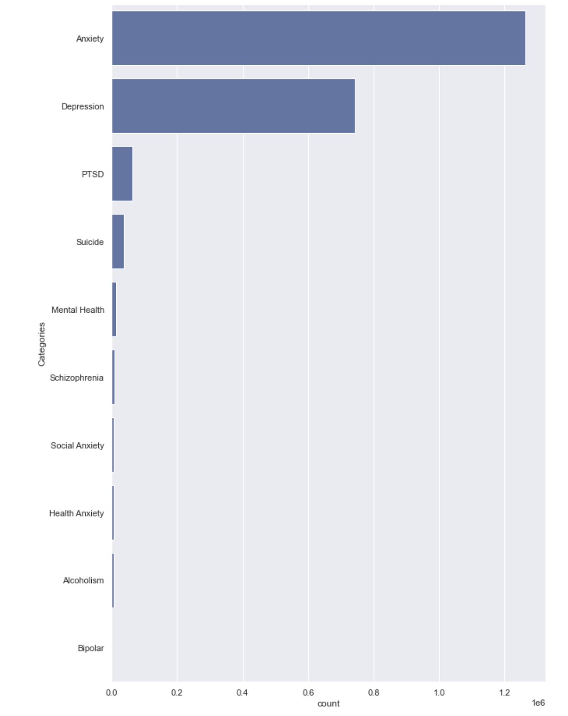
Overall Prediction Distribution
TYPE | PERCENTAGE
Anxiety | 58.78%
Depression | 34.56%
PTSD | 2.97%
Suicide | 1.70%
Mental Health | 0.64%
Schizophrenia | 0.41%
Social Anxiety | 0.31%
Health Anxiety | 0.31%
Alcoholism | 0.30%
Bipolar | 0.02%

Slide 14
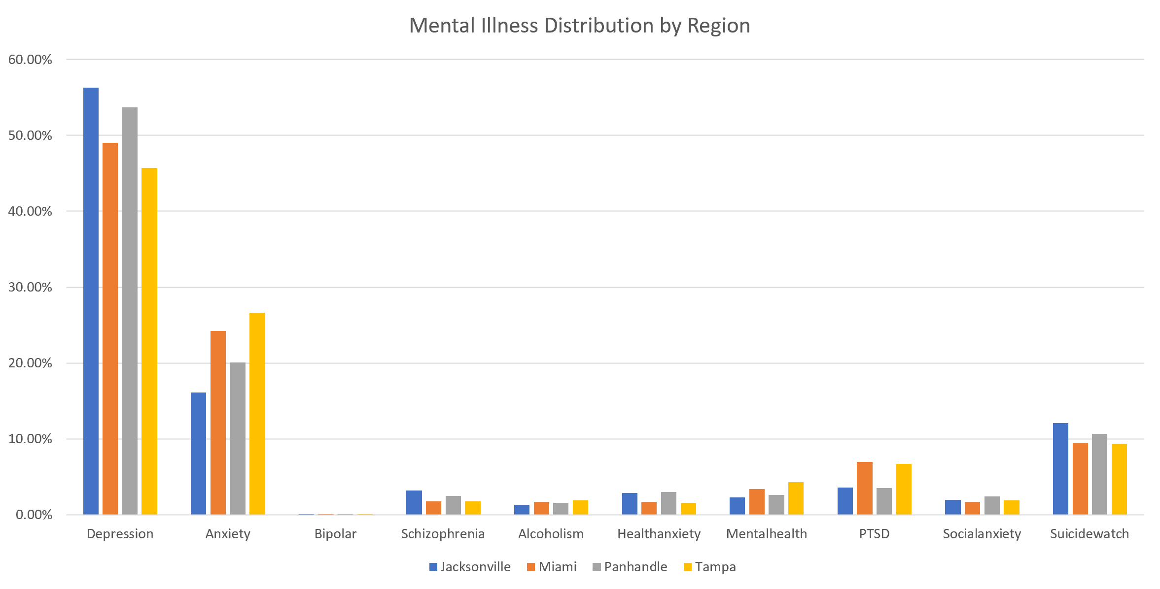
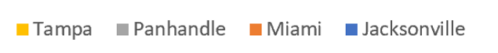
Mental Illness – Across Regions

Slide 15
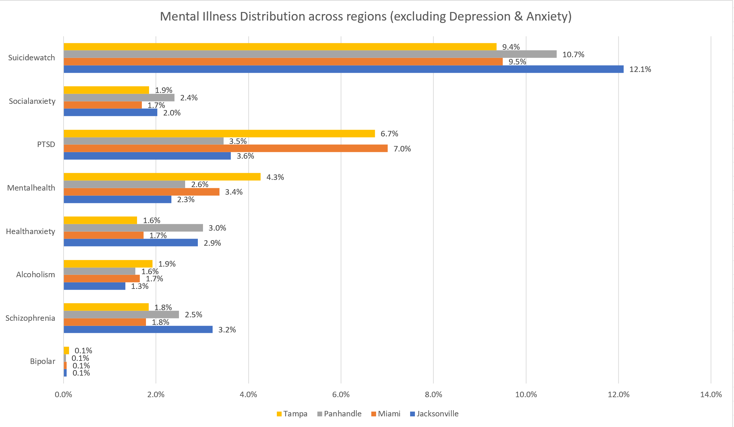
Mental Illness – Across Regions (excluding Depression & Anxiety)

Slide 16
Mental Illness – Key Takeaways
High scale detection of Depression & Anxiety in all regions, as this is the most common detected and diagnosed.
Jacksonville cluster has highest suicide prediction – 12.1%, followed by the Panhandle, at 10.7% in our samples.
PTSD has highest presence in the Miami cluster - 7%, followed by Tampa, at 6.7%.
Highest Schizophrenia was predicted for the Jacksonville cluster over others.
Panhandle cluster has the Health Anxiety, possibly owing to poor healthcare infrastructure availability.
Tampa region has the highest Mental Health & Alcoholism concerns over the other clusters, possibly a social lifestyle effect and correlated to mental illness, not causation.

Slide 17
Recommendations
Increase Suicide Prevention lines and awareness, mainly in the local Jacksonville and Panhandle clusters.
Conduct periodic surveys for mental well-being and behavioral health.
Collect this user survey data over a time period, understand mental health patterns and recommend specific health insurance plans to support them based on the highest ones in each cluster.
More health insurance options with specific behavioral therapy, group options and initial free sample sessions to encourage patient visit and sign up.
Conduct Behavior therapy sessions for those who suffer from depression & PTSD, mainly in Miami and Tampa clusters.
Conduct free/reduced cost counselling sessions to fight Anxiety with support groups.
Mandating few PTO days off for mental health and avoiding burnout/stress.
Investment in treatment of mental illnesses has 4 times the ROI. (https://www.who.int/news/item/13-04-2016-investing-in-treatment-for-depression-and-anxiety-leads-to-fourfold-return )

Slide 18
APPENDIX
References of Papers
Data Visualizations
Model Prediction Output Numbers

Slide 19
Thank you!

Slide 20
Literature Review & Papers
Here are the papers that were used as reference to understand the domain, problem and methodology.
PAPER | LINK
Ananthakrishnan, Uttara M and Tucker, Catherine E., The Drivers and Virality of Hate Speech Online (January 28,2022) | https://ssrn.com/abstract=3793801 or http://dx.doi.org/10.2139/ssrn.3793801
Sharath Chandra Guntuku, David B Yaden, Margaret L Kern, Lyle H Ungar, Johannes C Eichstaedt, Detecting depression and mental illness on social media: an integrative review, Current Opinion in Behavioral Sciences, Volume 18, 2017, Pages 43-49, ISSN 2352-1546 | https://doi.org/10.1016/j.cobeha.2017.07.005 or https://www.sciencedirect.com/science/article/pii/S2352154617300384
NLP Model for Effect of Social Media on Health. Duncan, Brianni | http://hdl.handle.net/1920/12187
Conway M, O'Connor D. Social Media, Big Data, and Mental Health: Current Advances and Ethical Implications. Curr Opin Psychol. 2016 Jun;9:77-82 | doi: 10.1016/j.copsyc.2016.01.004. PMID: 27042689; PMCID: PMC4815031.
Babu, N.V., Kanaga, E.G.M. Sentiment Analysis in Social Media Data for Depression Detection Using Artificial Intelligence: A Review. SN COMPUT. SCI. 3, 74 (2022). | https://doi.org/10.1007/s42979-021-00958-1
Coppersmith G, Leary R, Crutchley P, Fine A. Natural Language Processing of Social Media as Screening for Suicide Risk. Biomedical Informatics Insights. January 2018 | doi:10.1177/1178222618792860
Kim, J., Lee, J., Park, E. et al. A deep learning model for detecting mental illness from user content on social media. Sci Rep 10, 11846 (2020). | https://doi.org/10.1038/s41598-020-68764-y

Slide 21
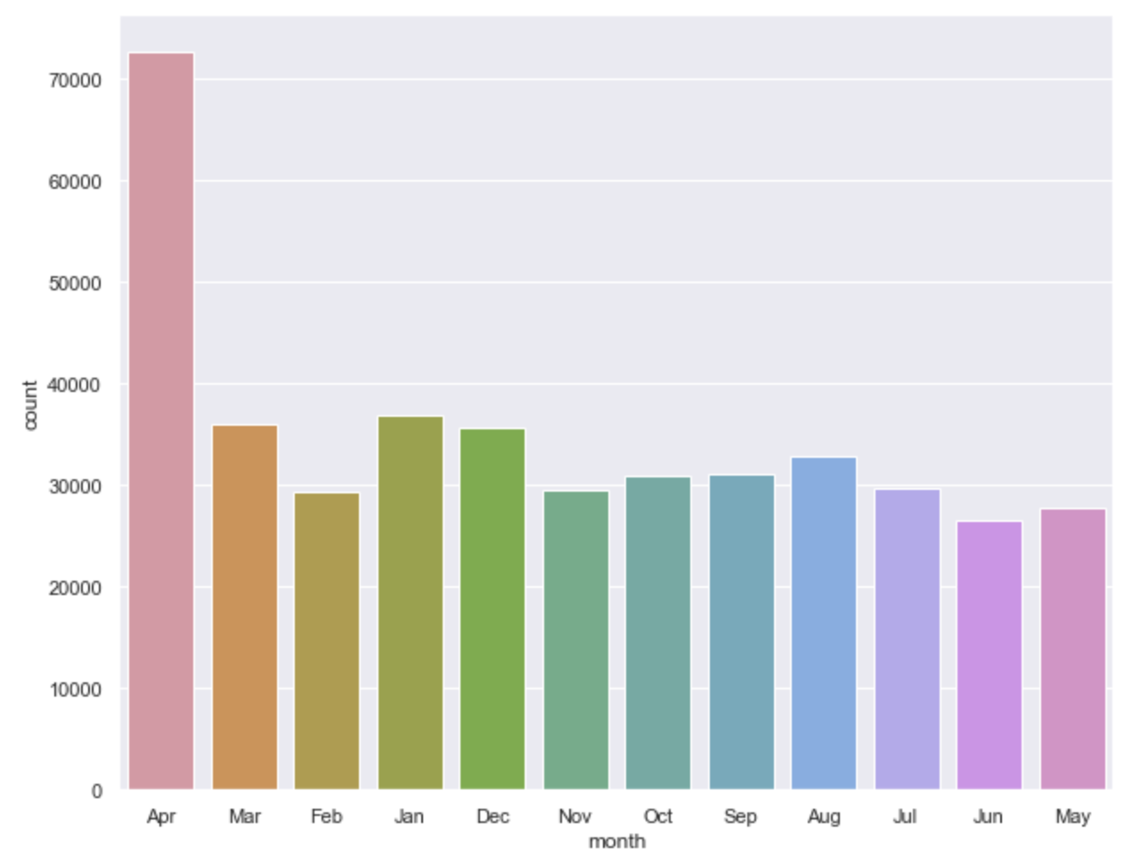
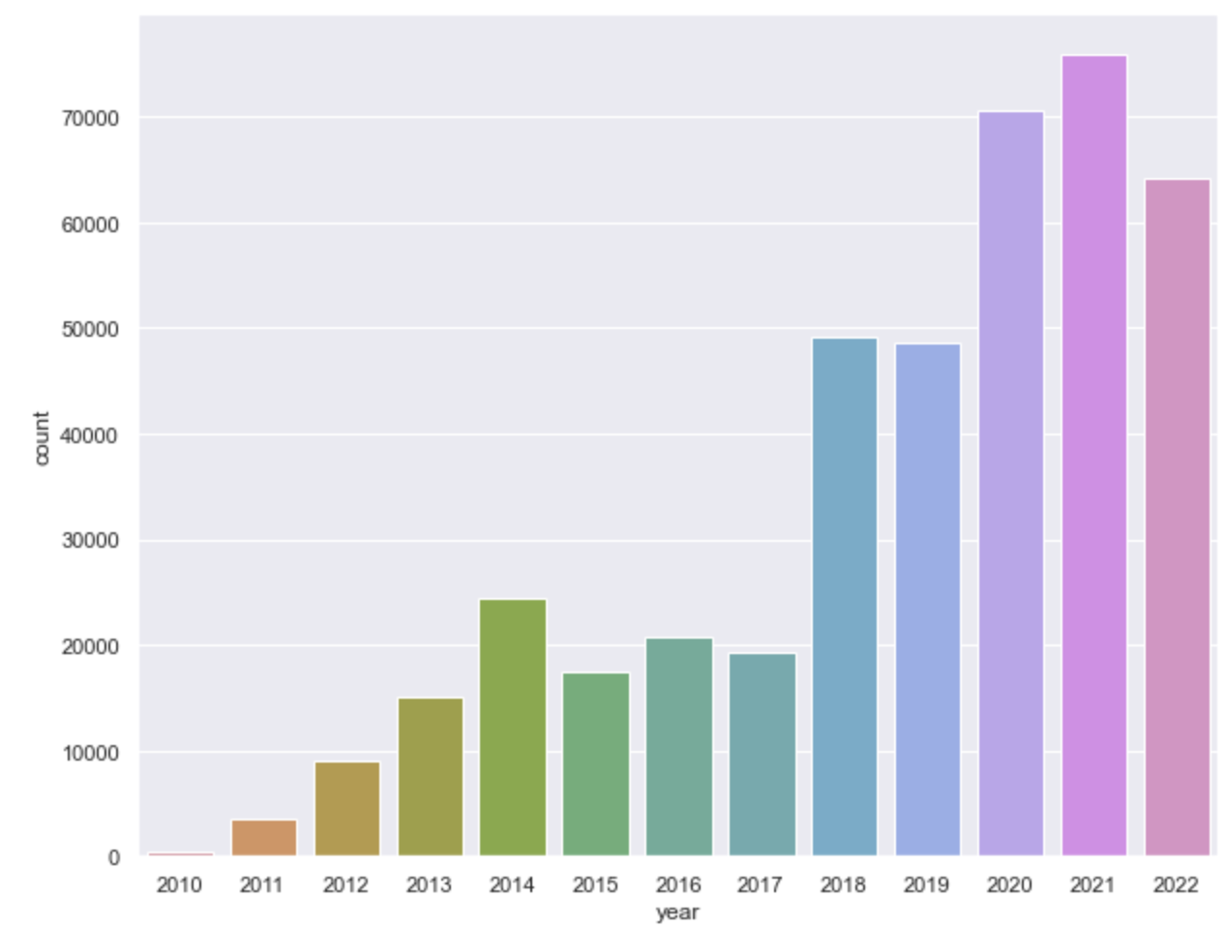
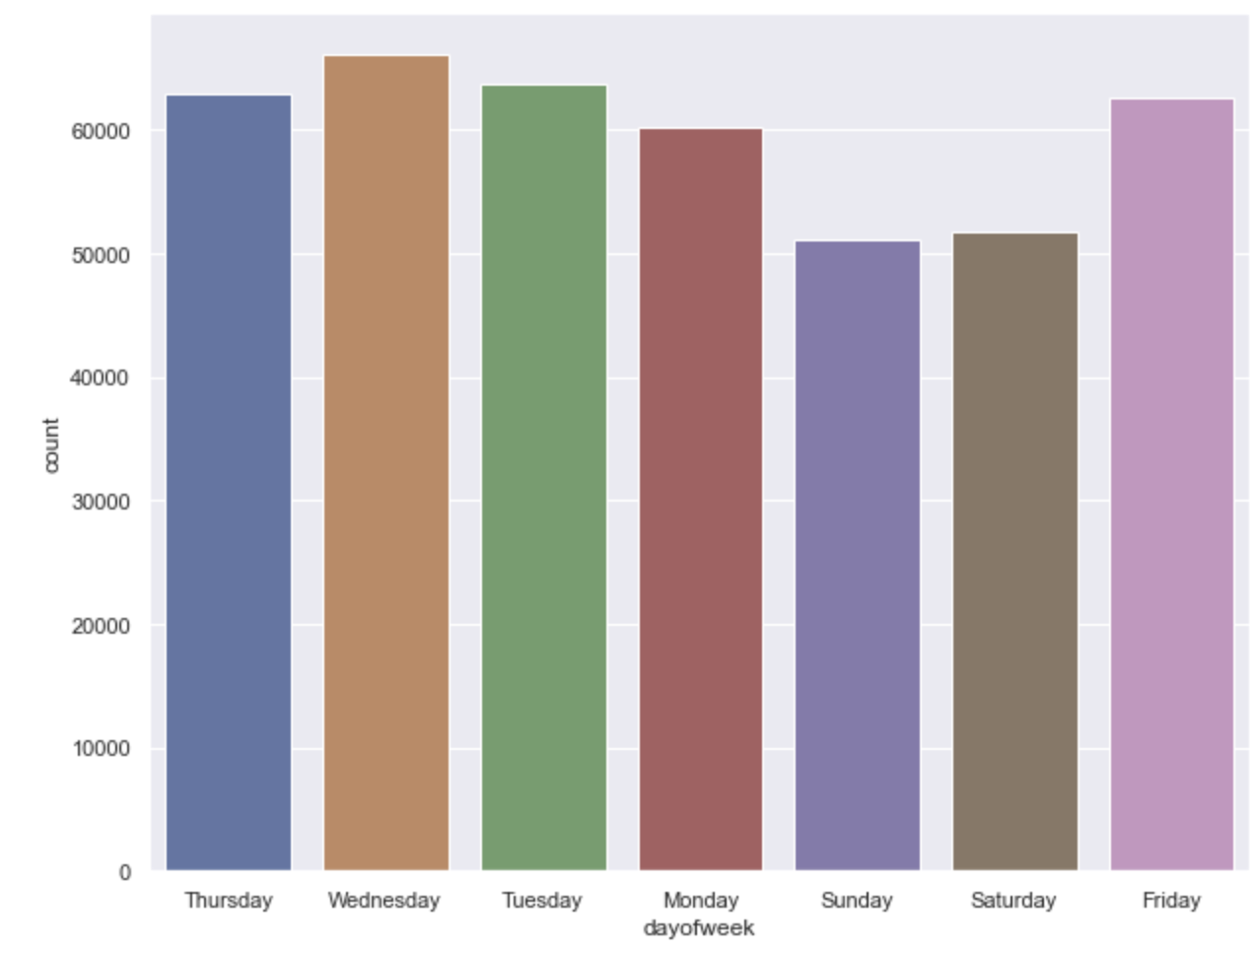
Data Visualizations – Tweet Distribution
By Month By Year By Day of the Week

Slide 22
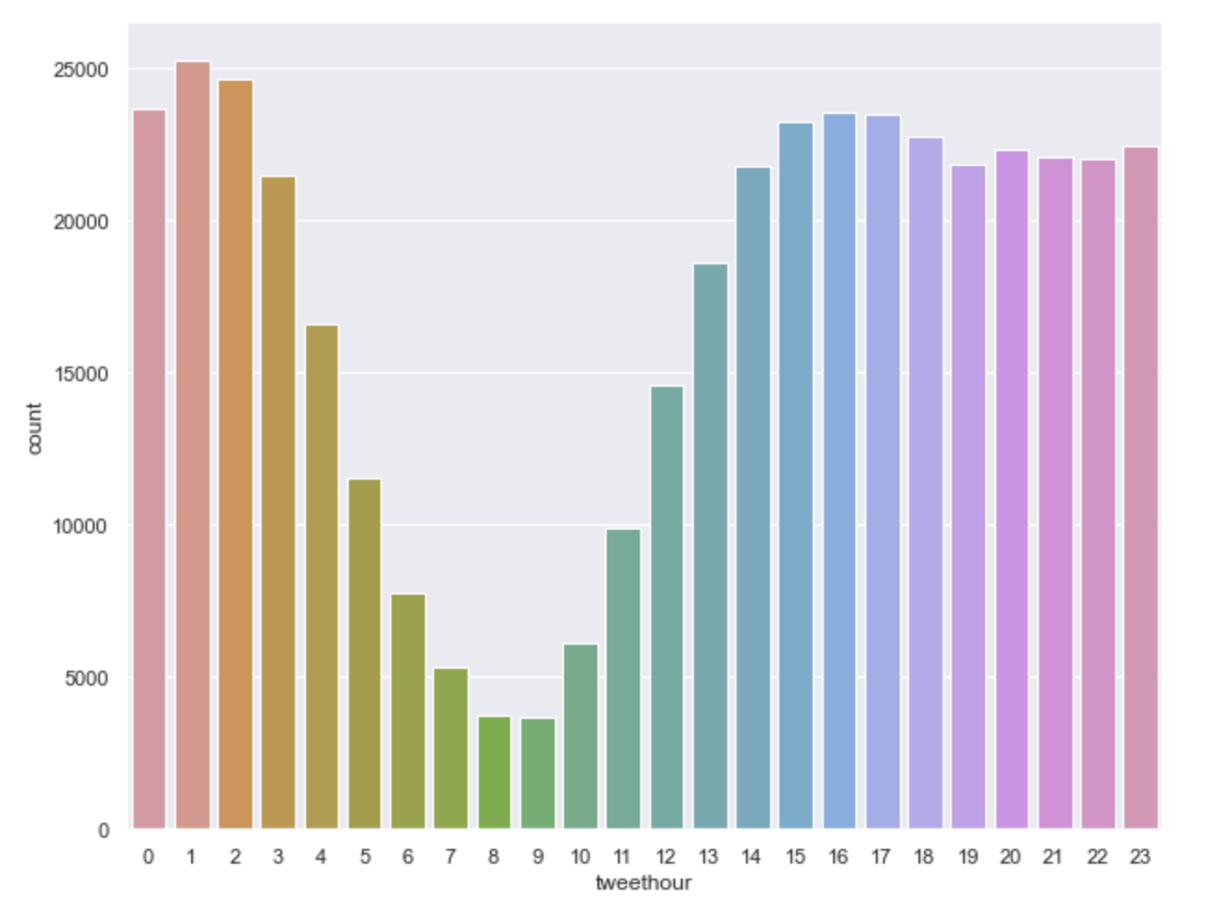
Data Visualizations – Tweet Distribution(contd.)
By Hour of the day

Slide 23
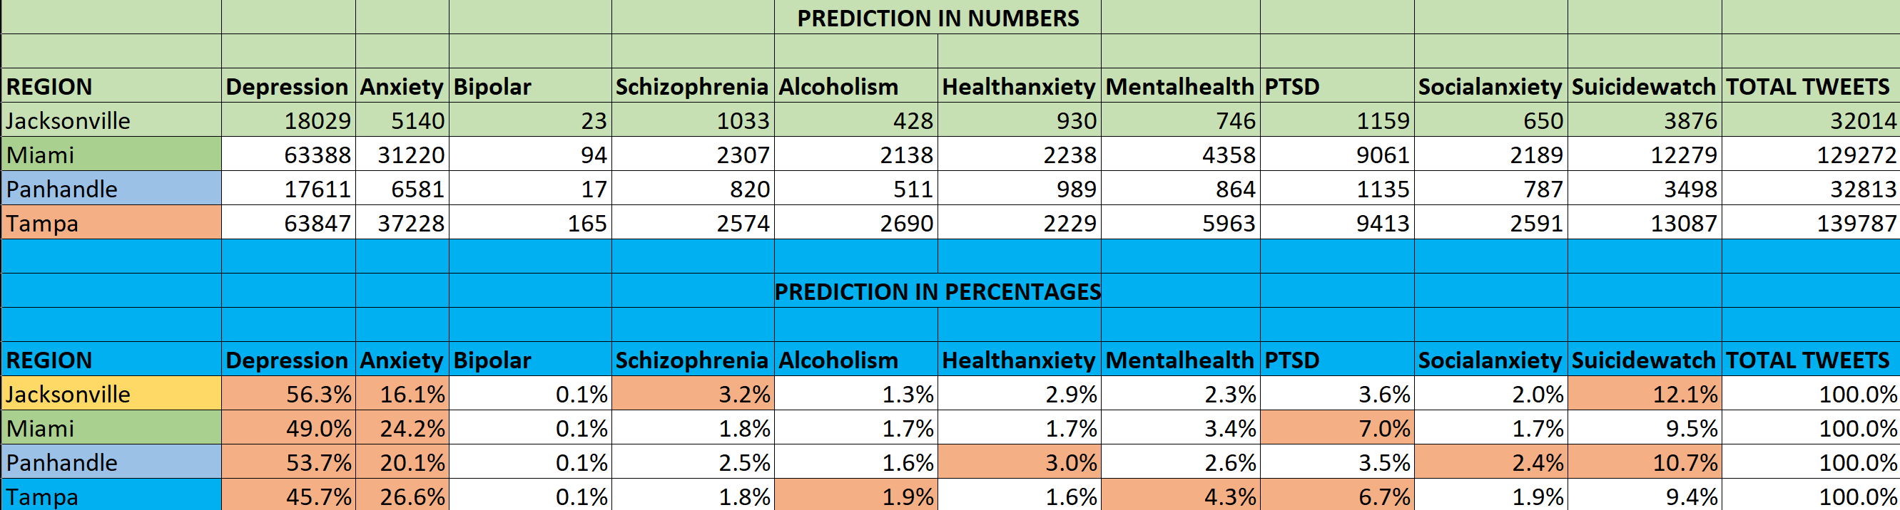
Mental Illness - Numbers vs Percentage
High scale detection of Depression & Anxiety in all regions, as this is the most common detected and diagnosed.
Jacksonville cluster has highest suicide prediction – 12.1%, followed by the Panhandle, at 10.7% in our samples.
PTSD has highest presence in the Miami cluster - 7%, followed by Tampa, at 6.7%.
Highest Schizophrenia was predicted for the Jacksonville cluster over others.
Panhandle cluster has the Health Anxiety, possibly owing to poor healthcare infrastructure availability.
Tampa region has the highest Mental Health & Alcoholism concerns over the other clusters, possibly a social lifestyle effect. – correlation , not causation.

